Slide 1
Dealing with STRESS

Slide 3
Common Life Stressors
Major life events: loss of loved one, divorce
Trauma: abuse, natural disaster
Social: relationships, family, loneliness, social anxiety
Financial: bills, debt, retirement
Work: operational tempo, deployments, job change, moves
Health: poor eating habits, lack of sleep, chronic health problems
Substance abuse: caffeine, alcohol, medications, smoking, drugs
Notes:
Self-care Strategies
Identify current coping and self-care strategies
Make a commitment to yourself
Break the Conspiracy of Silence – Talk about what is troubling you
Build positive personal and professional support systems that does not fuel your stress
Recognize your personal limitations by establishing boundaries

Slide 4
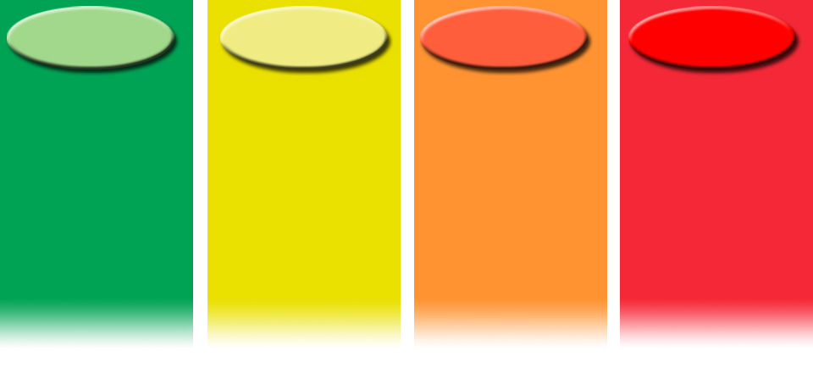
THE STRESS SCALE
Ready
Stressor
Reacting
Injured
Ill
Adaptive coping
Optimal functioning
Wellness
Features
Well trained and prepared
Fit and focused
In control
Optimally effective
Behaving ethically
Mild and transient distress or loss of optimal functioning
Temporary & reversible
Low risk for illness
Features
Irritable, angry
Anxious or depressed
Physically too pumped up or tired
Reduced self-control
Poor focus
Poor sleep
More severe and persistent distress or loss
Higher risk for illness
Causes
Wear and Tear, Inner Conflict, Loss, Trauma
Features
Panic or rage
Loss of control of body/mind
Can’t sleep
Recurrent nightmares/bad memories
Persistent shame, guilt
or blame
Loss of moral values
and beliefs
Persistent and disabling distress or loss of function
Unhealed stress injuries
Mental disorder
Types
PTSD
Major Depression
Anxiety
Substance abuse
Features
Symptoms and disability persist over many weeks
Symptoms and disability get worse over time

Slide 5
THE STRESS SCALE
Green “Ready” | Yellow “Reacting” | Orange “Injured” | Red “Ill”
Healthy
Well
Fit
Safe
Connected
Capable
Confident
Drained
Sore
Irritable
Anxious
Down
Routine Stressors
Cumulative Stress
Persistent distress
Loss of function
Unable to fall asleep
Panic or blind rage
Losing moral values
Clinically symptomatic
Impaired
Disordered
Worsening
Resilience
?
Toxic Stressors
Recovery
Recovery
Notes:
Stress Continuum – A lens to understand injuries and illness
The stress continuum can also be used as a lens to understand how some people rebound and others may become injured or ill. When people have the resources and skills to grow from stress experiences we call it resilience. And for most people, that is what happens. Then stressors are sufficiently toxic; such as life threat, loss, and inner conflict; or exhaust skills and resources a stress injury can occur. It is important to understand that even very fit and resilient people have limits to coping skills and resources.
When stress injuries mix with genetic code, brain chemistry, alcohol or drugs people can develop stress related illnesses. The key for treating these illnesses are mostly based on returning balance to the control centers in the brain and increasing coping skills and resources.

Slide 6
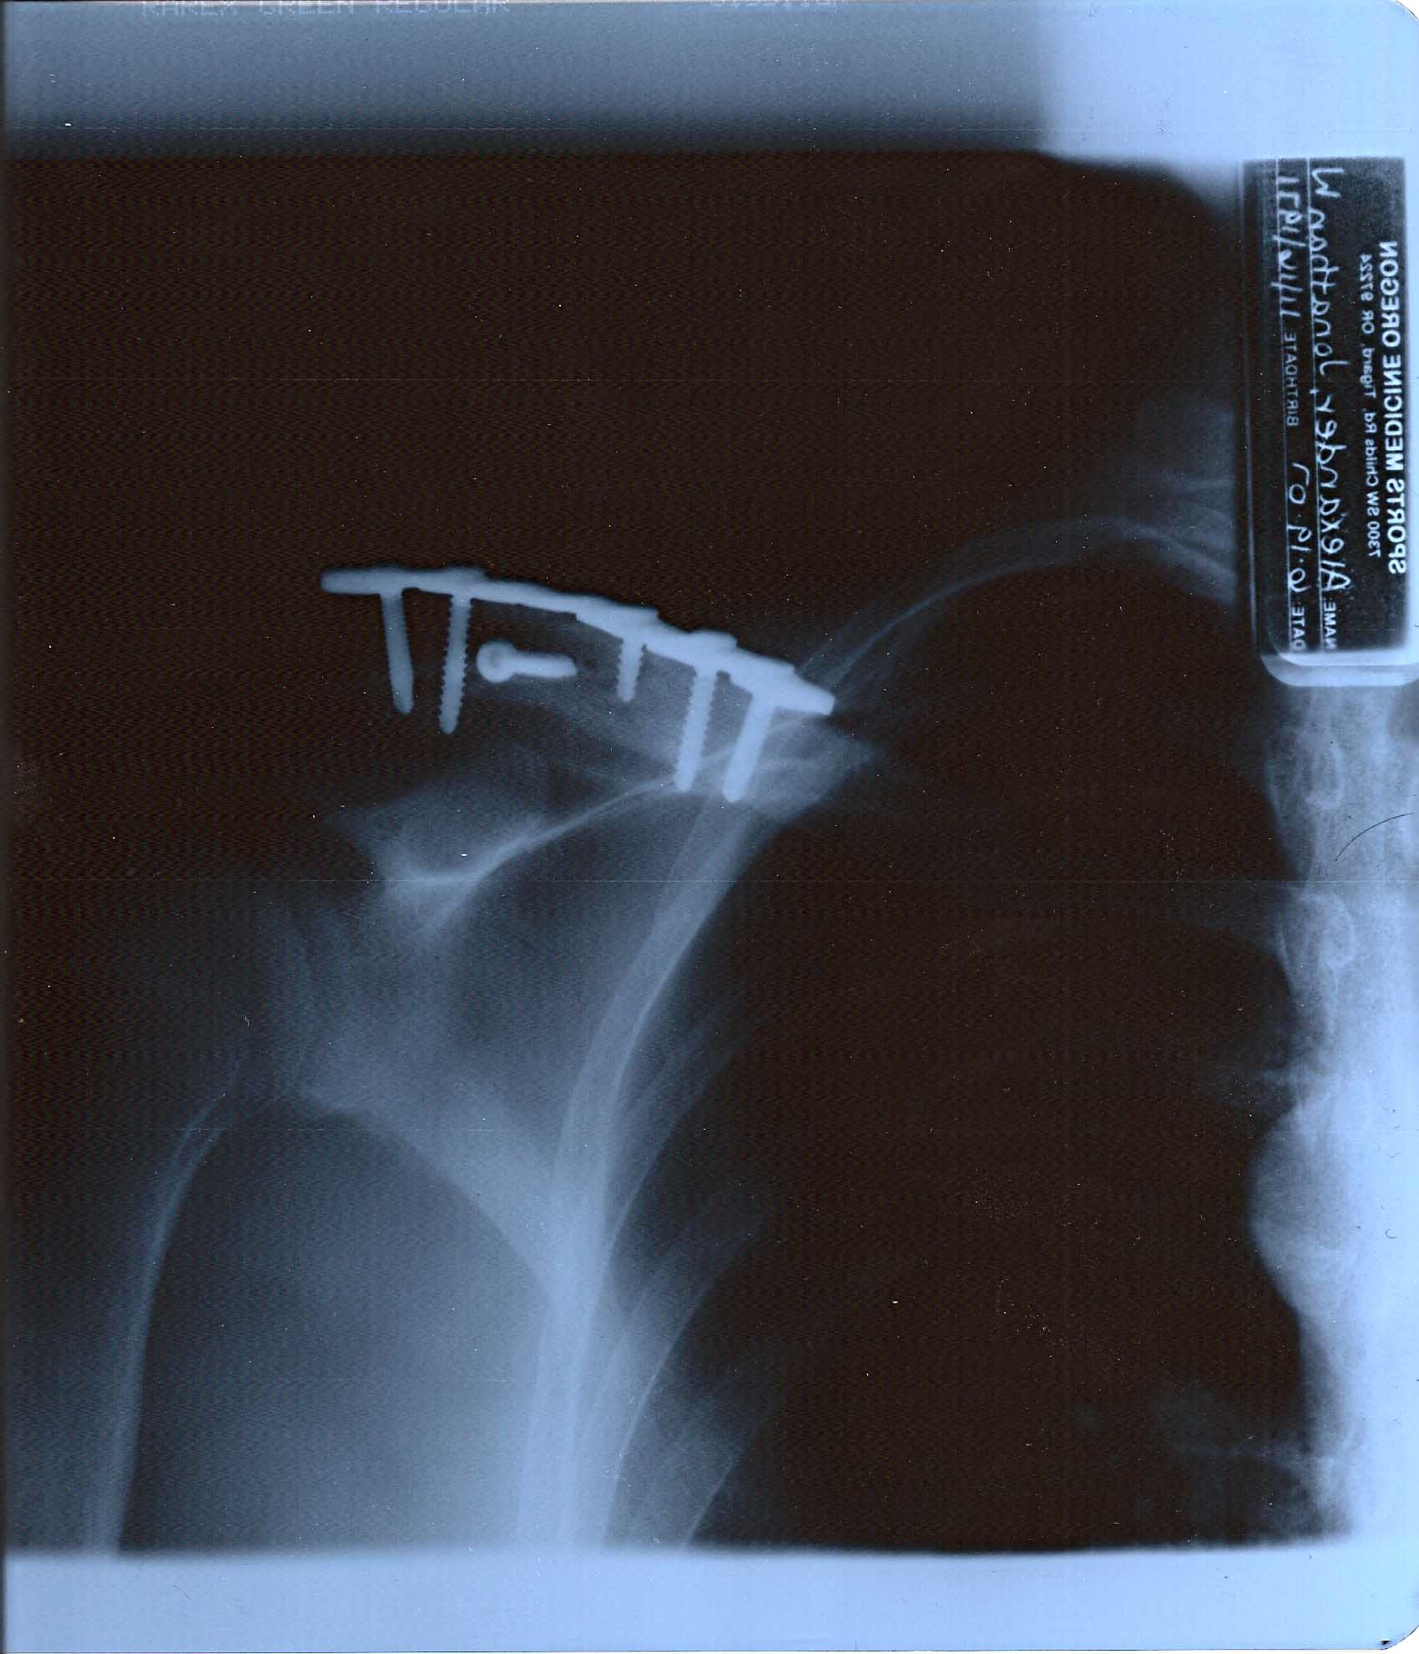
Yellow Zone vs. Orange Zone
THE STRESS SCALE
Stress Reactions
Bending from stress
Very common
Normal
Typically go away
Stress Injuries
Damage from stress
Less common
Risk for role failure
Risk for stress illness
Notes:
Yellow Zone vs. Orange Zone
Stress reactions are common and are a part of developing connectedness, competence, and confidence in facing life challenges. Most people have sufficient resources and skills to reset following a stress reaction.
Stress injuries cause damage to the mind and brain that result in functional impairment and typically require activation of additional resources to facilitate recovery and growth.
Facilitate participant input:
What are some of the sources of stress reaction in your peers and friends?

Slide 7
Four Sources of Stress Injury
THE STRESS SCALE
“WILT”
Ready
Reacting
Injured
Ill
Wear & Tear
Inner
Conflict
Loss
Trauma
A fatigue injury
Accumulation of all stress over time
Depression, anxiety
Ethical or moral betrayal
Violation of deeply held beliefs
Anger, shame, revenge, guilt
A grief injury
Loss of cherished people or things
Guilt, sadness, longing
A life-threatening stress injury
Close brush with death
Terror, horror, helplessness
Notes:
Four Sources of Stress
Trauma is not the only harmful exposure. If we do not also account for loss, inner conflict, and fatigue then leaders only listen for the metaphorical boom versus looking for the wires that lead to the explosion.
Four Sources of Stress Injury:
1) Life Threat— due to traumatic life-threatening or other situations provoking terror, horror, or helplessness
Seeing someone die
Felling helpless
Traumatic life event
2) Wear and Tear - due to fatigue and accumulation of prolonged stress, including from non-operational sources, without sufficient sleep, rest, and restoration
Fatigue or prolonged stress
Can be non-operational because of insufficient sleep/rest/restoration
3) Loss -grief due to the loss of close comrades, leaders, or other cared-for individuals
Grief due to loss of a relationship
Death of close comrades, leaders, friends to family members
4) Inner Conflict/Moral Injury - A beliefs injury due to conflict between moral/ethical beliefs and current experiences such as taking action outside of the rules of engagement; where there is harm to an innocent life; not preventing harm to a buddy
Beliefs injury – conflict between personal ethics/morals
Unable to prevent harm to a buddy
Survivor’s guilt

Slide 8
THE STRESS SCALE
Ready
Reacting
Injured
Ill
More severe and persistent distress or loss
Higher risk for illness
Causes
Wear and Tear, Inner Conflict, Loss, Trauma
Features
Panic or rage
Loss of control of body/ mind
Can’t sleep
Recurrent nightmares/ bad memories
Persistent shame, guilt
or blame
Loss of moral values
and beliefs
Persistent and disabling distress or loss of function
Unhealed stress injuries
Mental disorder
Types
PTSD
Major Depression
Anxiety
Substance abuse
Features
Symptoms and disability persist over many weeks
Symptoms and disability get worse over time
Adaptive coping
Optimal functioning
Wellness
Features
Well trained and prepared
Fit and focused
In control
Optimally effective
Behaving ethically
Mild and transient distress or loss of optimal functioning
Temporary & reversible
Low risk for illness
Features
Irritable, angry
Anxious or depressed
Physically too pumped up or tired
Reduced self-control
Poor focus
Poor sleep
Train hard
Build the team

Slide 9
THE STRESS SCALE
Ready
Reacting
Injured
Ill
More severe and persistent distress or loss
Higher risk for illness
Causes
Wear and Tear, Inner Conflict, Loss, Trauma
Features
Panic or rage
Loss of control of body/ mind
Can’t sleep
Recurrent nightmares/ bad memories
Persistent shame, guilt
or blame
Loss of moral values
and beliefs
Persistent and disabling distress or loss of function
Unhealed stress injuries
Mental disorder
Types
PTSD
Major Depression
Anxiety
Substance abuse
Features
Symptoms and disability persist over many weeks
Symptoms and disability get worse over time
Adaptive coping
Optimal functioning
Wellness
Features
Well trained and prepared
Fit and focused
In control
Optimally effective
Behaving ethically
Mild and transient distress or loss of optimal functioning
Temporary & reversible
Low risk for illness
Features
Irritable, angry
Anxious or depressed
Physically too pumped up or tired
Reduced self-control
Poor focus
Poor sleep
Train hard
Build the team
Talk to someone you trust

Slide 10
THE STRESS SCALE
Ready
Reacting
Injured
Ill
More severe and persistent distress or loss
Higher risk for illness
Causes
Wear and Tear, Inner Conflict, Loss, Trauma
Features
Panic or rage
Loss of control of body/ mind
Can’t sleep
Recurrent nightmares/ bad memories
Persistent shame, guilt
or blame
Loss of moral values
and beliefs
Persistent and disabling distress or loss of function
Unhealed stress injuries
Mental disorder
Types
PTSD
Major Depression
Anxiety
Substance abuse
Features
Symptoms and disability persist over many weeks
Symptoms and disability get worse over time
Adaptive coping
Optimal functioning
Wellness
Features
Well trained and prepared
Fit and focused
In control
Optimally effective
Behaving ethically
Mild and transient distress or loss of optimal functioning
Temporary & reversible
Low risk for illness
Features
Irritable, angry
Anxious or depressed
Physically too pumped up or tired
Reduced self-control
Poor focus
Poor sleep
Train hard
Build the team
Talk to someone you trust
Talk to chaplain, counselor, or medical

Slide 11
THE STRESS SCALE
Ready
Reacting
Injured
Ill
More severe and persistent distress or loss
Higher risk for illness
Causes
Wear and Tear, Inner Conflict, Loss, Trauma
Features
Panic or rage
Loss of control of body/ mind
Can’t sleep
Recurrent nightmares/ bad memories
Persistent shame, guilt
or blame
Loss of moral values
and beliefs
Persistent and disabling distress or loss of function
Unhealed stress injuries
Mental disorder
Types
PTSD
Major Depression
Anxiety
Substance abuse
Features
Symptoms and disability persist over many weeks
Symptoms and disability get worse over time
Adaptive coping
Optimal functioning
Wellness
Features
Well trained and prepared
Fit and focused
In control
Optimally effective
Behaving ethically
Mild and transient distress or loss of optimal functioning
Temporary & reversible
Low risk for illness
Features
Irritable, angry
Anxious or depressed
Physically too pumped up or tired
Reduced self-control
Poor focus
Poor sleep
Train hard
Build the team
Talk to someone you trust
Talk to chaplain, counselor, or medical
Seek medical attention

Slide 12
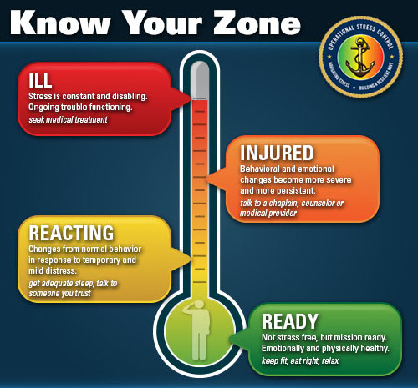

Slide 13

Develop a Self-Care Plan
Four self-care domains
  Physical, Emotional, Social, Spiritual
Make a commitment to yourself
Don’t suffer in silence – talk about what is troubling you
Recognize your personal limitations by establishing boundaries
Build positive personal and professional support systems that energize you
Develop your own self-care plan
Notes:
Self-care Strategies
Identify current coping and self-care strategies
Make a commitment to yourself
Break the Conspiracy of Silence – Talk about what is troubling you
Build positive personal and professional support systems that does not fuel your stress
Recognize your personal limitations by establishing boundaries

Slide 14


Resources
CG Support
www.cgsuprt.com
855-CG SUPRT
Counseling
Financial
Health
Legal
Personal Growth
Chaplain
Jonathan Alexander
202-774-8788
Jonathan.W.Alexander@
uscg.mil

Slide 15
Questions?

Slide 16
Resources
CG Support
www.cgsuprt.com
855-CG SUPRT
Counseling
Financial
Health
Legal
Personal Growth
Chaplain
Jonathan Alexander
202-774-8788
Jonathan.W.Alexander@
uscg.mil

